Slide 1
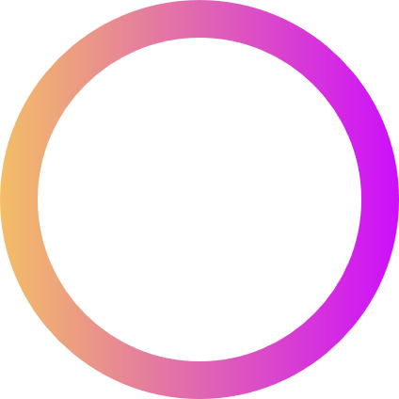



AI & ML
MEDISCAN
Team ID: 42
SCRIPT SURFERS

Slide 2


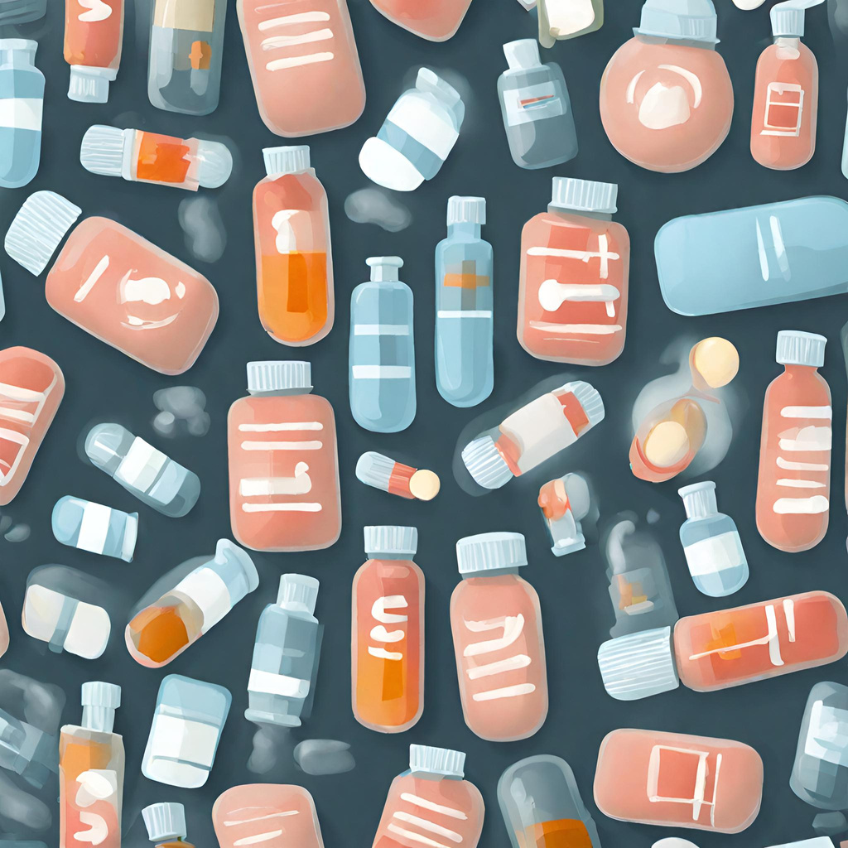


Problem Statement
SCRIPT SURFERS
Problem
The current healthcare landscape presents a significant challenge in the form of adverse drug reactions and medication errors, which affect millions of individuals annually. These issues pose substantial health risks, lead to financial losses, and can even result in fatalities.
Numbers and data
In India, medication errors are estimated to cause around 400,000 deaths annually, with adverse drug reactions (ADRs) accounting for 720,000 ADRs
in united states , the there is 1 death in 8 patients but in India this number is 1 death in 4 patients from error in medication
In a study in Delhi, India, the occurrence of medication errors was as high as 82/1,000 prescriptions, and the national figures report up to 5.2 million medical errors annually
Medication errors can lead to temporary or permanent harm to patients, increased length of hospitalization, and increased cost of treatment

Slide 3
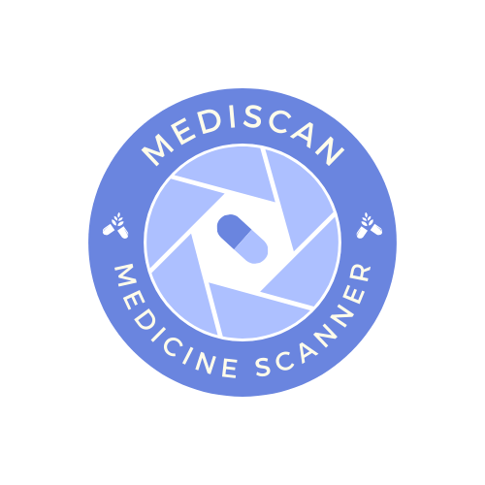
Solution
SCRIPT SURFERS
Our app, MediScan, is a simple and smart solution that allows you to scan any medicine using your smartphone camera and get instant information about it. With MediScan, you can:
Learn about the ingredients, dosage, side effects, interactions, and warnings of any medicine
Verify the authenticity and quality of the medicine
Get personalized recommendations and reminders based on your health profile and preferences
MEDiSCAN: THE POWERFUL TOOL

Slide 4
TEAM NAME
Timeline for
Hackathon
Ideation
Presentation
Round 1
Round 2
Our team is preparing to articulate the problem in a comprehensive way to ensure your understanding of the associated concerns and issues. We will showcase our prototype, provide flowcharts to illustrate data movement, and explain the functionality of our technology stack. This approach aims to foster a clear and thorough understanding of our solution.
During the second phase, we will address the bugs and feedback received from our application's test run. Our focus will be on resolving these issues and finalizing the application's functionality, including the integration of planned features. This iterative process ensures our application meets the highest standards of quality and user satisfaction.
Upon recognizing the profound societal impact of medication errors, our team committed to developing a platform or application. This tool is designed to enhance citizens’ understanding of their medications, with the ultimate goal of reducing related casualties to zero. This initiative underscores our dedication to improving public health and safety.
In the first phase, we will conduct an in-depth investigation of the problem. Following this, we will construct a demo or prototype of our application, guided by our flowcharts. Finally, we will initiate the testing stage of our application to ensure its functionality and effectiveness.

